Slide 1

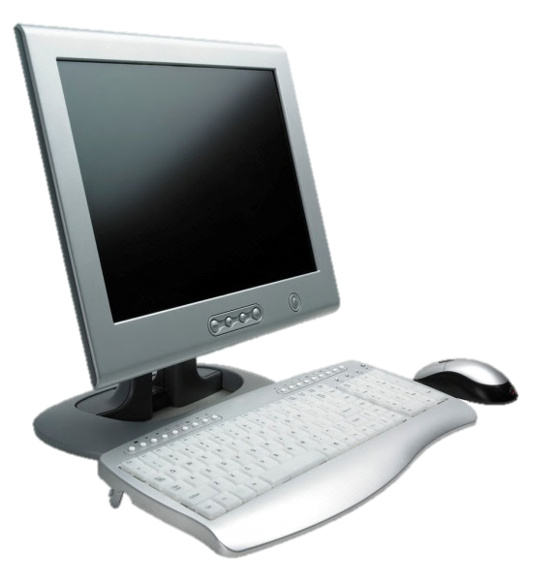
System Requirements
OneClick Go! Version 2.7
Minimum software and hardware required to run OneClick Go! is as follows
Hardware Configuration
Processor : Pentium III 700 MHz
RAM: 128 MB
Free Space: 10 MB
Display Device: A device with 64 MB of Video Memory
Other: Keyboard and mouse
Software Configuration
Operating System: Windows Xp SP2
Windows Media Player: Version 9
Adobe Acrobat Reader: Version 1.5 (Optional: For viewing Help)
Visual Basic: Version 6.0 (Optional: For Program Development)
Inno Setup Compiler: Version 5 (Optional: For Setup Development)
Microsoft PowerPoint: Version 14 (Optional: For Visual Interface Development)
Greenfish Icon Editor: Professional 2 (Optional: For Icon Development)

